Slide 1
Reading for Meaning
How to help your children move on in reading.

Slide 2
Reading the words is just the start
In order to read fluently, we need a lot of practice with hearing how good reading sounds and with reading out loud.
Read aloud often to your child.
The more often he/she hears a story, the more familiar the words will become and the easier it will be for your child to read.

Slide 3
Reading for Meaning
Decoding
Making connections
Thinking
Evaluating

Slide 4
Your goal is to help your child be an active reader.
Read together and talk about what’s happening as they’re reading. Stop and discuss any interesting or tricky words. Talk about any surprising or sad passages and help them visualise parts of the story. Ask your child, “Do you understand what’s happening here? What do you think will happen next?” If your child seems unsure, stop, go back and reread if necessary. Discuss any confusing parts. – Make a character family tree.

Slide 5
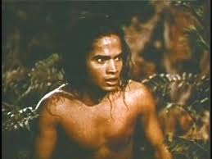
Question Types
LITERAL questions: Ones where we can find the answer directly in the text. To answer them well we need to read the text very carefully and find the exact words that tell us what the questions asks.
Who are the main characters?
Where is the story set?

Slide 6
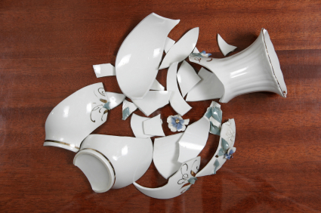
DEDUCTIVE questions: Ones where the text does not actually tell us, but we can work out the answer directly from information the text gives us. To answer them well we need to read the text very carefully and
work things out from the information.
Mum stared at the broken vase and slowly picked up the pieces without speaking.
How was mum feeling?

Slide 7
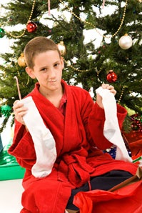
INFERENTIAL questions:
Ones where the text does not actually tell us, but we can work out the answer by considering the hints and clues in the text in the light of our own knowledge and experience.
“Oh thanks Gran! Socks –
just what I wanted for
Christmas!” said Josh with
a thin smile.
How do you know that Josh didn’t like what Gran had bought him?

Slide 8
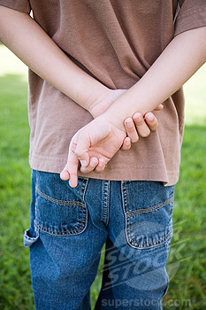
Evaluative questions: Ones that ask us what the writer has done and why. To answer these well we need to read the text very carefully and try to put ourselves in the writer’s place (i.e. ‘read like a writer’). We need to think about what the writer was trying communicate and how he/she went about doing it.
And it was just at that moment,
I said it. I hadn’t meant to lie
but somehow it just slipped
out.
Is it ever right to lie? What would you have done differently? Do you feel sorry for him? How does the writer make you feel sorry for him?

Slide 9

Reading for Pleasure

Slide 10
Children who read for pleasure are likely to do better in maths and English than those who rarely read in their free time, research suggests.
The study, by the Institute of Education, London University, examined the reading habits of 6,000 children.
There was a 14.4% advantage in vocabulary, a 9.9% advantage in maths and an 8.6% advantage in spelling.
Study author Dr Alice Sullivan said: "It may seem surprising that reading for pleasure would help to improve children's maths scores.
"But it is likely that strong reading ability will enable children to absorb and understand new information and affect their attainment in all subjects.“ (BBC News 11 September 2013)

Slide 11
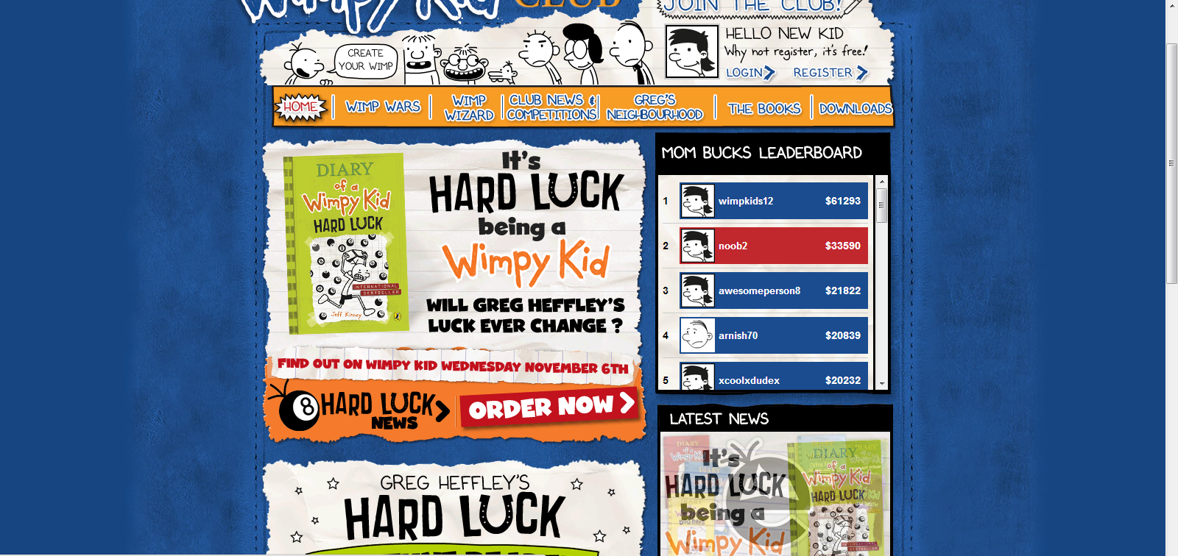
Nurture a love for specific authors. Many authors have their own website
http://www.wimpykidclub.co.uk/

Slide 12
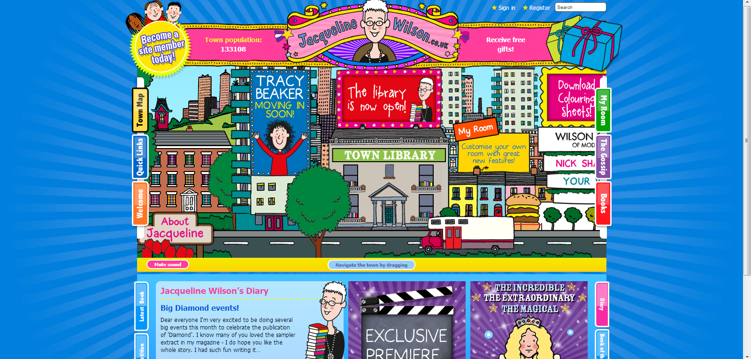
http://www.jacquelinewilson.co.uk/

Slide 13
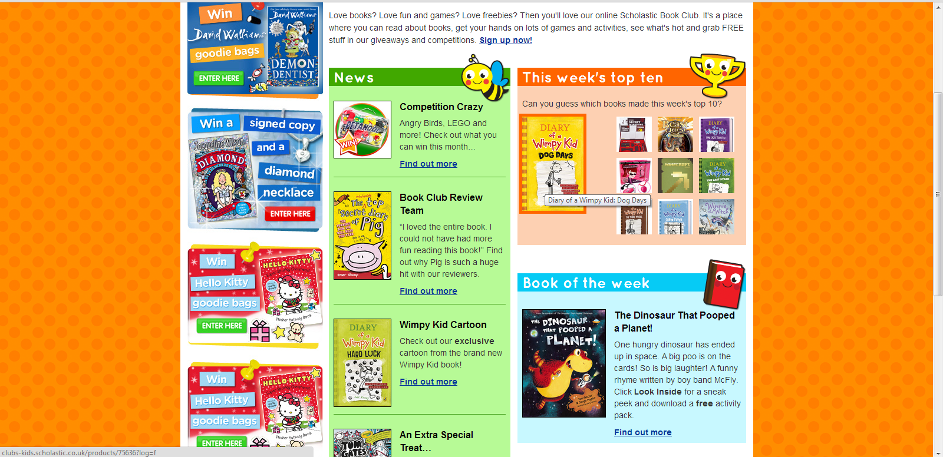
http://clubs-kids.scholastic.co.uk/

Slide 14
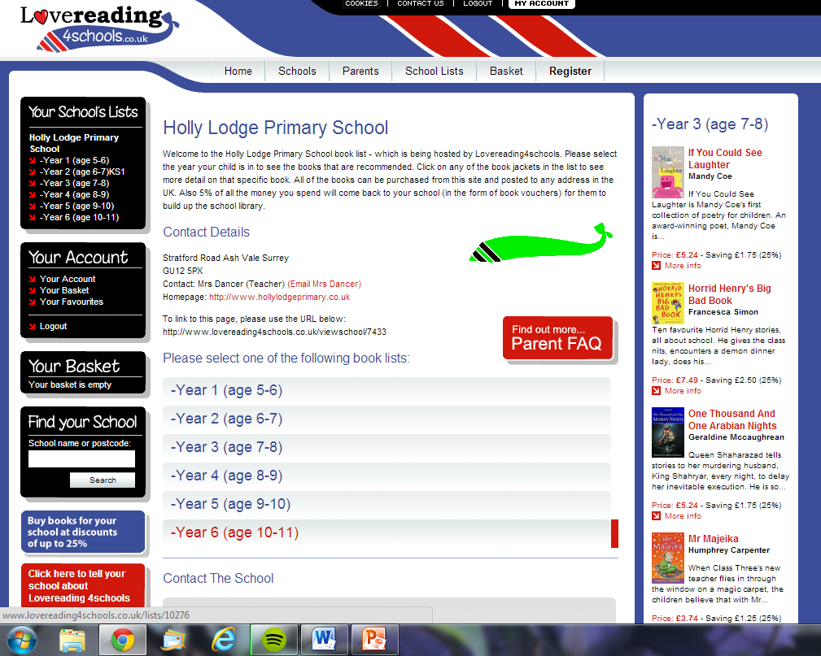
http://www.hollylodgeprimary.co.uk/topic/school-life
Holly Lodge website
School Life
Lovereading

Slide 15

Make sure the book is not too hard for them to read independently.
Swap books with friends.
Find out why it’s “boring”.
Enjoy higher level books together – a paragraph each.
Kindle/ audio books
Read to your child – set aside a time.
Read anything and everything that interests them.
Read separately together.
Enjoy the words.
Make up own stories.

